Slide 1
Utilizing Blockchain and Smart Contracts to Enable Audit 4.0: A Case Study of Accountability Audit of Air Pollution Controls In China
Jun Dai
School of Accounting, Southwestern University of Finance and Economics
Chengdu, Sichuan, China, 611130
jundai@swufe.edu.cn

Slide 2
Background
Industry 4.0 became publicly known at Hannover Fair in 2011. It has quickly spread across the world, especially in the EU, the US, China ,and Brazil.
Advances in smart sensors, Internet of Things (IoT), Internet of Service (IoS), Cyber-Physical Systems (CPS), and Smart factory promote the new industry revolution.
Audit 4.0 piggybacks on technologies promoted by Industry 4.0 to collect financial and operational information, as well as other audit-related data from an organization and its associated parties.
It analyzes, models, and visualizes data in order to discover patterns, identify anomalies, and extract other useful information for the purpose of providing effective, efficient, and real-time assurance.

Slide 3
Overview of Audit 4.0
Mirror World
Value
Auditors
Location
Status
Supplier
Smart TV
Company
RFID
GPS
sensor
chip
Company
Supplier
Smart TV
Physical world

Slide 4
Challenges in Audit 4.0
Digital crime: Because Audit 4.0 relies on large amounts of data from various sources, ensuring data authenticity and integrity will be a critical issue to achieve Audit 4.0.
Compromise of modules: A lot of intelligent audit modules will be distributed and embedded throughout organizations and even across the entire value chain. Ensuring correct operations of those modules and protect them from being compromised is also challenging.
Potential Solutions: Blockchain and smart contracts

Slide 5
Reengineering of Audit Processes to Enable Audit 4.0
Audit 4.0 collects data using smart sensors, IoT, and other technologies, and performs a variety of tests and analytics via intelligent audit modules to identify anomalies and useful information.
Blockchain ensures the reliability and integrity of the audit-related data collected in Audit 4.0.
Smart contracts enforce the correct operations of the intelligent audit modules without human intervention.

Slide 6
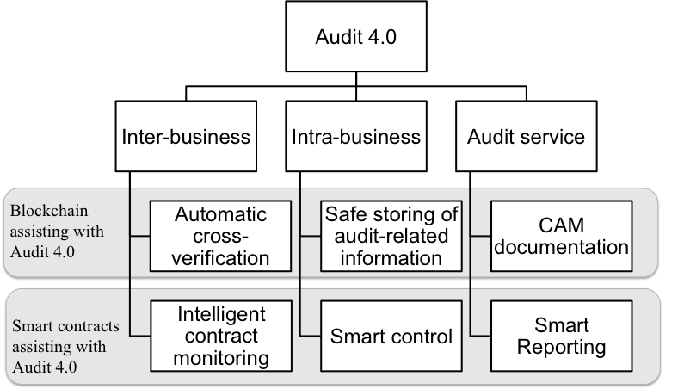
A Framework of Applying Blockchain and Smart Contracts to Audit 4.0
Crowdsour-cing data validation

Slide 7
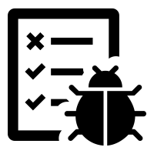
Linking Blockchain to Audit 4.0
Mirror world
Smart reporting layer
Smart reporting contract
Auditor, manager, investor
Continuous auditing
Continuous monitoring
Fraud detection
Process mining
Smart contract layer
Crowdsourcing
data
Accounting
data
IoT data
Non-financial information
System log
Blockchain layer
Data control layer
Data source control
Data authenticity control
Related business entities
Notes:
Bring in steps
Talk about audit 4.0

Slide 8
Applying Audit 4.0 to Accountability Audit of Air Pollution Controls In China
Environmental accounting and auditing recently raise attentions from both academia and practice because of accelerating climate change, desertification, pollution, etc. (Burritt and Christ 2016; Deegan 2017; Fu, Hao, and Chen 2015; Prajogo and Lai 2016; Russell, Milne, and Dey 2017).
In 2017, Chinese government issued a new regulation on the accountability audit of natural resource, including air, and considered it as an important factor for government officials’ evaluation.

Slide 9
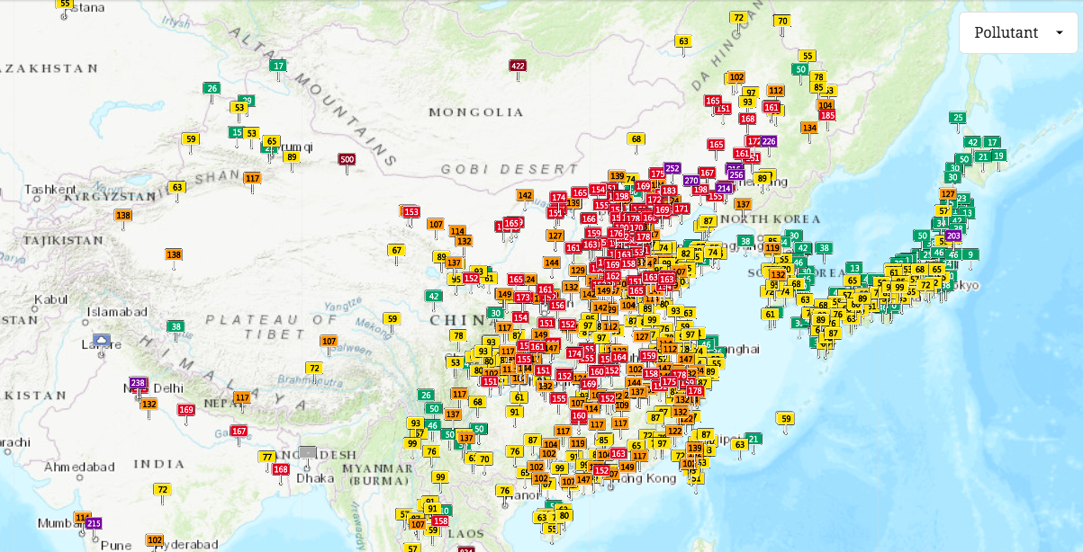
Air Pollution In China
Picture source: https://waqi.info/. Accessing time: Oct 18, 2018, at 9:40am EDT.

Slide 10
Problems in the Accountability Audit of Air Pollution Controls
Problems uncovered by pilot accountability audits performed by local audit offices in recent years and prior works (Burritt and Christ 2016; IFAC 2005) include:
Difficulties in timely and accurately data acquisition
Labor-intensive and costly processes
Problems in data authenticity and integrity
Ineffectiveness of ex-post audit results

Slide 11
A Continuous Accountability Audit System
A continuous accountability audit system is designed to evaluate officials’ performance on air pollution controls based on Audit 4.0, blockchain, and smart contracts.
Audit 4.0: real-time air data collection via crowd sourcing
Blockchain: ensure data integrity
Smart contracts: data validation, data monitoring against predetermined rules and reporting anomalies to relevant parties in real time
Participants: government officials, government auditors, environment protection agencies, polluting enterprises, citizens, and media

Slide 12
System Design

Slide 13
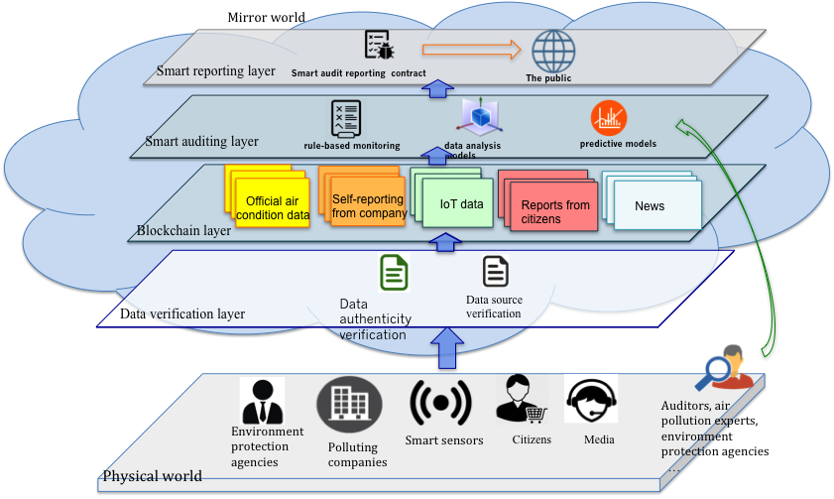
The Vision of the Continuous Accountability Audit System

Slide 14
Demo
The Ethereum Ropsten Testnet was used as the blockchain platform to create the demo. https://ropsten.etherscan.io/
Two researchers uploaded real PM 2.5 values (a popular air quality indicator) at their places to the blockchain from May 14 to June 1, 2018
The official PM2.5 values were also collected from a public website, and uploaded to the blockchain
A total of 144 data points were uploaded. The average number of data points uploaded per day is 7.58

Slide 15
Steps
1. Setting up rules for monitoring officials’ performance on air pollution controls
Monitoring of PM 2.5
>75 μg/m3 -> “Too High! Immediate actions should be taken”
<75 μg/m3 and >35 μg/m3 ->“High! Further investigations should be performed”
<35 μg/m3 -> ok
2. Setting up rules for verifying data sources
Three data sources
ID=“111” ->public record
ID=“123” ->real air data collected from one researcher
ID=“666” ->real air data collected from another researcher

Slide 16
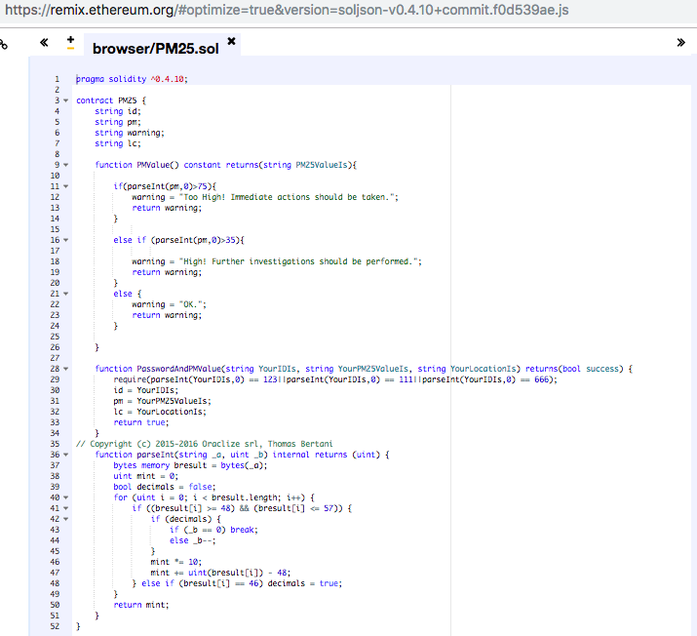
Demo (cont.)
3. Embedding rules into a smart contract

Slide 17
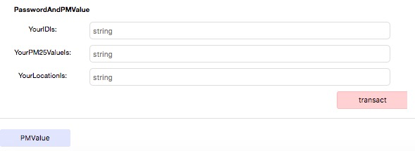
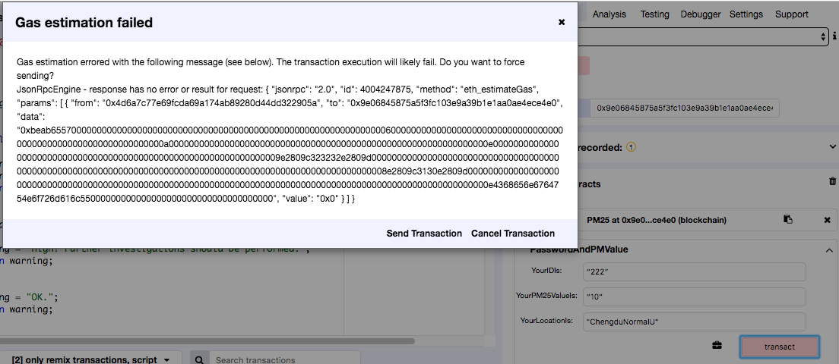
Demo (cont.)
4. Data input

Slide 18
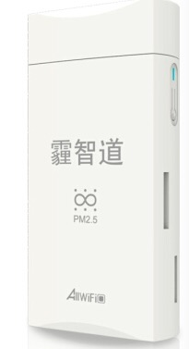
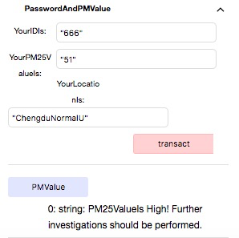
Demo (cont.)
5. Recording
6. Monitoring and reporting

Slide 19
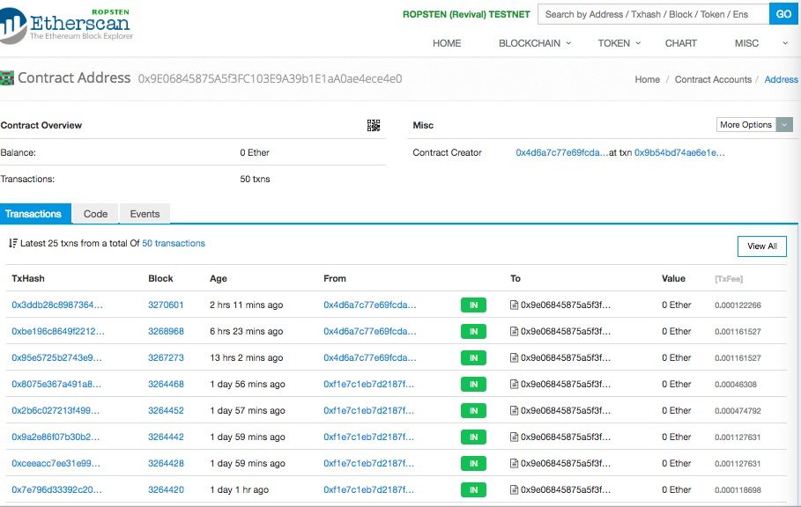
A Sample of Air Quality Transactions
https://ropsten.etherscan.io/address/0x9e06845875a5f3fc103e9a39b1e1aa0ae4ece4e0

Slide 20
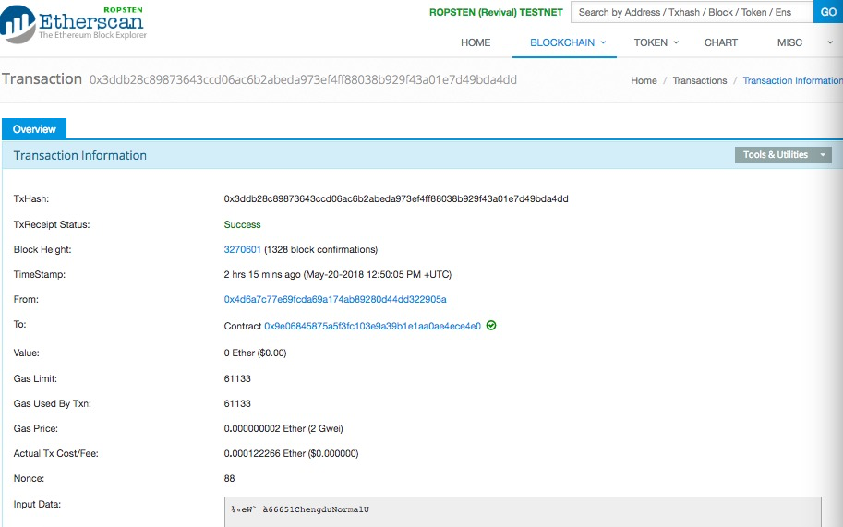
Detailed Information of A Specific Transaction
https://ropsten.etherscan.io/tx/0x3ddb28c89873643ccd06ac6b2abeda973ef4ff88038b929f43a01e7d49bda4dd

Slide 21
Challenges
Inaccuracy and instability of crowd-sourcing monitoring equipment
Identify erroneous or fraudulent data
Difficulty in performing complex computation
Reluctance of government officials to adopt this system
Over sensitive audit results
Auditor’s lack of knowledge in technologies
s

Slide 22
Conclusion
This paper creates a research framework to explore how to use blockchain and smart contracts to enable Audit 4.0.
This paper discusses and demonstrates the use of Audit 4.0, blockchain, and smart contracts in accountability audit of air pollution controls in China.
It provides insights for government, auditors, as well as regulators, to use new technologies to improve the effectiveness and efficiency of assurance.

Slide 23
Thank you!

Slide 24
Evolution of Auditing: From 1.0 to 4.0

Slide 25
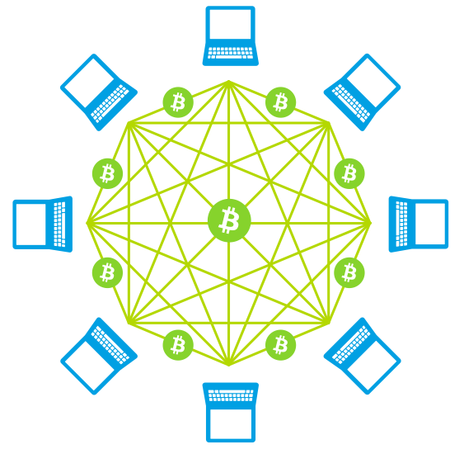
Blockchain
A secure, trusted, and distributed database
It utilizes a network of nodes to collectively perform authentication, reliable data storing and management
ledger
ledger
ledger
ledger
ledger
ledger
ledger
ledger

Slide 26
How Does It Work?
https://www.youtube.com/watch?v=r43LhSUUGTQ
Decentralized and distributed
Strong authentication
Tamper-resistant
Notes:
Another video

Slide 27
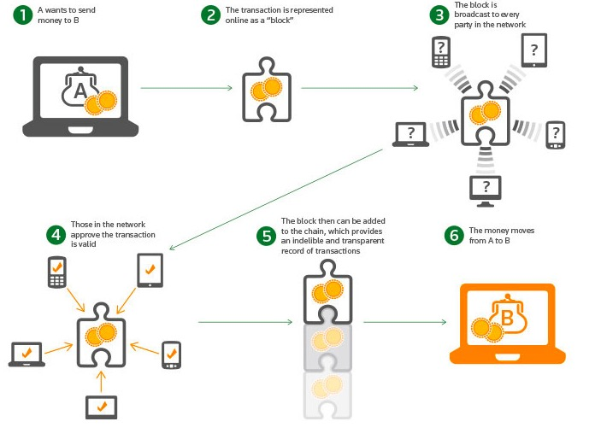

Slide 28
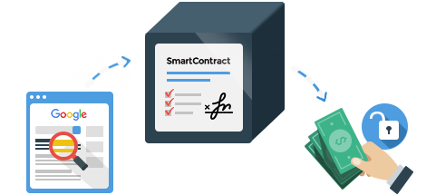
Smart Contracts
Computer programs that autonomously verify, enforce, and execute the terms in contracts
Embed in smart contract
c
Covenant
Bank
Company
Notes:
Covenant debt (company example)
Do not know when the should recall
Smart contract automatically activate the portion of the contract which increase the interest rate
Smart contract go to compnay’s ERP daily and monitor and analyze the data, enable self calculated continuous reporting
Interact with the erp, continuously monitor the company’s financial status, make the decision whether

